Slide 1

Public data for the public good: working with Ombudsman Schemes
Universities Policy Engagement Network (UPEN)
25 February 2026
Donal Galligan, Chief Executive
Notes:
Give an overview of the OA itself and ombudsman landscape
Explain the role of an ombudsman and the insight that they hold

Slide 2



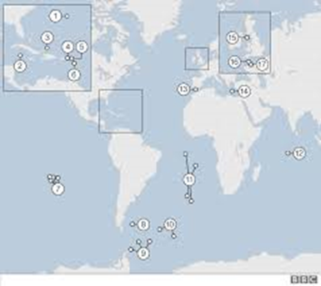
The OA
Cover the United Kingdom, Republic of Ireland, British Crown Dependencies, and British Overseas Territories
Set the Standard:
Independence
Fairness
Effectiveness
Openness and transparency
Accountability
Criteria recognised by UK Government:
  UK Cabinet Office Guidance
  Companies House criteria
Notes:
The Ombudsman Association was established in 1993 and includes as members all public and private sector Ombudsman schemes, and major complaint handling bodies, in the four nations of the United Kingdom, in the Republic of Ireland, the British Crown Dependencies [i.e.: the Channel Islands and the Isle of Man] - And the British Overseas Territories around the world, such as, Gibraltar, Bermuda, and the Cayman Islands.
33 Ombudsman Members, across 11 different nations and territories.
Within that geographical coverage we set the criteria for how an ombudsman should be set up, their governance, and what they should be doing.
Our criteria recognised as best practice:
Cabinet Office Guidance to UK Government Departments on setting up an ombudsman scheme;
‘Ombudsman’ being a sensitive term at Companies House: a business operating in the UK can only use the term if they meet our criteria (not retrospective!)

Slide 3
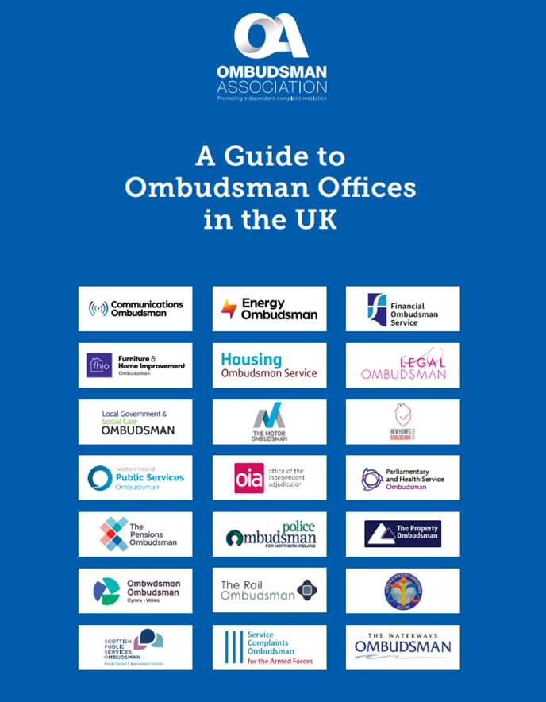
All aspects of life
Across the UK: 22 Ombudsman Members
(and 17 Complaint Handler Members)
  Public services (central, local, devolved)
  Financial services
  Armed forces
  Police
  Care homes
  Legal services
  Pensions
  Property / Housing
  Higher Education
  Essential services (e.g. energy, communications, rail)
  Consumer goods (e.g. cars, home improvements)
Notes:
Ombudsman schemes are an alternative to the Courts - an independent redress model, free at the point of use for citizens and consumers, that can drive systemic change, tackle injustice, and help organisations (whether public or private) to perform more efficiently and effectively.
In terms of the UK: 22 Ombudsman Members and 17 Complaint Handler Members - cover both public services and those in the private / consumer sector. That includes both statutory offices, that are compulsory for all providers in that sector, and those schemes that are voluntary for the sector in question.
Covering complaints about everything from the NHS; energy companies; Financial services; Legal services; broadband; care homes; fitted kitchens; trains; housing etc…

Slide 4
Role of an Ombudsman
Complaints are ‘a window into the soul of an organisation’
An Ombudsman = Champion for Fairness (“Unsung heroes”)
Identify systemic issues and provide feedback to improve services and complaint handling
Unique intelligence: > Million complaints each year, Thousands of lived experiences
Notes:
Window: how complaints are dealt with reveal true culture in an organisation, not the stated one. And can provide an early warning system on potential systemic process or service design failures.
Ombudsman schemes, which were described by the Master of the Rolls (at the launch of the Online Procedure Rules Committee) as “the unsung heroes of the justice system”, offer more than just basic transactional complaint handling which simply picks a ‘winner’ in a dispute. Resolving an individual dispute is of course key to those individuals involved, but the real value in the ombudsman model is their role in feeding back the lessons from their work in order to help secure redress for others in a similar situation, and to improve service delivery and complaints management for the future; all based on what is ‘fair and reasonable’.
For that reason, an ombudsman is sometimes described as being more like a doctor than a police officer, diagnosing what is wrong and making recommendations to improve. And it is in that guise, as an ‘agent of change’, that they can play a role in rebuilding trust and public and consumer confidence.
And each of those 22 ombudsman schemes are valuable intelligence generating organisations. As a result of them collectively dealing with over a million complaints each year, they have a treasure trove of 1000s of ‘lived experiences’ of people's problems with a range of public services and private sector organisations.
But unfortunately, due to capacity and resource constraints, ombudsman schemes often struggle to measure the impact their work is having and the difference they make more broadly. And that’s where LGSCO’s collaborations with researchers comes in…

Slide 5
Why now? Call for action
Total cost of consumer detriment in the UK est. £71.2 billion (DBT, 2024)
Increasing demand in every sector across UK:
  Communications Ombudsman up 54%; Housing Ombudsman and Motor Ombudsman both up 42%; Scottish Public Services Ombudsman up 39%; Legal Ombudsman 37%...
Policy solution of choice: Water industry, Private Rented Sector…
And yet, HMT Review of Financial Ombudsman Service…
Ethics & Integrity Commission review on reform (March 2026)
Ombudsman sector is keen to engage – get in touch!
Notes:
People’s rights have never mattered more:
DBT’s Consumer Detriment Survey 2024 showed 7 in 10 UK consumers had a negative experience with an item or service (in 12 months to April/May 2024) – poor quality products, being defective or unsafe, delivery issues, and complete failure to provide. Total cost of consumer detriment in the UK estimated £71.2 billion (up from £54 billion in 2021)
MoJ Legal Problem and Resolution survey (2023) showed that ‘certain groups of the population are far more likely to experience problems than others (people from ethnic minority backgrounds, adults with long-term health conditions, those on means-tested benefits, and single parents).’
And Citizens Advice have a whole webinar series on the ongoing impact that the cost-of-living crisis is still having on ‘working people’
Increasing year on year demand across ombudsman sector (Institute for Fiscal Studies research re. public sector ombudsman realm).
Policy history has frequently been that the victims of injustice have often struggled to have their voice heard until a scandal, tragedy, or major failing occurs – after it does, creation of an ombudsman, or expansion of an existing one, is regularly part of the Government’s preferred policy solution e.g. Water industry and Private Rented Sector.
But at the same time the Treasury Review of FOS has questioned the value of the ombudsman, that ‘fair and reasonable’ approach, claiming it creates uncertainty for businesses and so constrains economic growth… so there is clearly a need for greater understanding of the impact ombudsman schemes have.
Ethics & Integrity Commission review – following CSPL 2025 report into ‘Recognising and responding to early warning signs in public sector bodies’, which questioned the value of public inquiries, EIC’s first review will ‘look at whether ombudsman schemes in the public sector should play a greater role in investigating systemic issues before they escalate and supporting public bodies to instigate swift and meaningful improvements to public services’.
So, the services that ombudsman schemes provide are in unprecedented demand, the data they hold and insight they provide is unique, and regularly seen as essential by Governments’ seeking to address systemic issues and drive change, and yet at the same time there is uncertainty over how much impact they do have – all at a time when organisations are expected to justify their existence and value for money.
So we think this provides a great opportunity for researchers to tackle questions that really matter for citizens and to help drive improvements - and the sector is keen to engage! We have research and policy networks that draw together all of our members and I’m happy to act as a facilitator to help anyone interested get in touch with them.

Slide 6



Get in touch
Email: donal.galligan@ombudsmanassociation.org
@OmbudAssoc
@OmbudsmanAssociation
That OA Thing – Podcast (YouTube and Spotify)
www.ombudsmanassociation.org

Slide 7
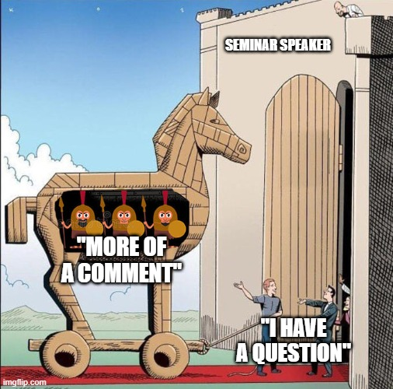
Q&A
Any questions?
Notes:
Q&A
Invite questions or feedback from attendees.

