Slide 1
Welcome to this event;
Public data for the public good: working with Ombudsman Schemes
Please bear with us while everybody joins.
We plan to get started in a few moments.
UPEN – 25 Feb 2026

Slide 2

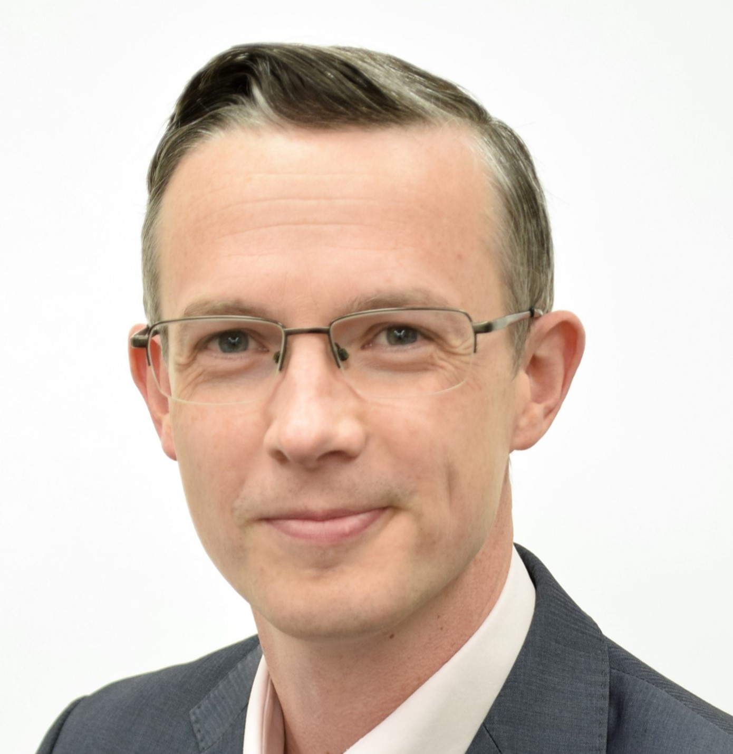

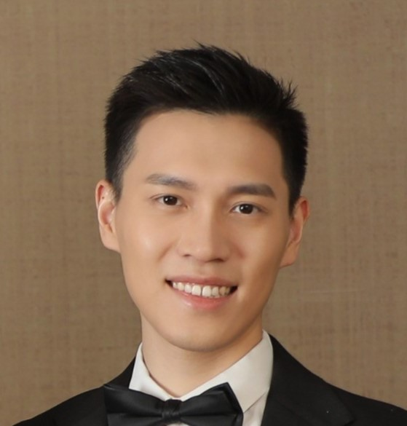
Our panel today:
Chair
Nicky Buckley,
UPEN and University of Cambridge
Dónal Galligan
Chief Executive,
Ombudsman Association
Michael Hyatt
Professional Practice lead,
Local Government & Social Care Ombudsman
Han Wang
Lecturer in Economic Geography,
University of Southampton
UPEN – 25 Feb 2026

Slide 3

Public data for the public good: working with Ombudsman Schemes
Universities Policy Engagement Network (UPEN)
25 February 2026
Donal Galligan, Chief Executive
Notes:
Give an overview of the OA itself and ombudsman landscape
Explain the role of an ombudsman and the insight that they hold

Slide 4



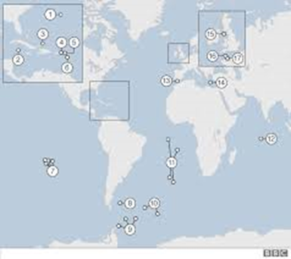
The OA
Cover the United Kingdom, Republic of Ireland, British Crown Dependencies, and British Overseas Territories
Set the Standard:
Independence
Fairness
Effectiveness
Openness and transparency
Accountability
Criteria recognised by UK Government:
  UK Cabinet Office Guidance
  Companies House criteria
Notes:
The Ombudsman Association was established in 1993 and includes as members all public and private sector Ombudsman schemes, and major complaint handling bodies, in the four nations of the United Kingdom, in the Republic of Ireland, the British Crown Dependencies [i.e.: the Channel Islands and the Isle of Man] - And the British Overseas Territories around the world, such as, Gibraltar, Bermuda, and the Cayman Islands.
33 Ombudsman Members, across 11 different nations and territories.
Within that geographical coverage we set the criteria for how an ombudsman should be set up, their governance, and what they should be doing.
Our criteria recognised as best practice:
Cabinet Office Guidance to UK Government Departments on setting up an ombudsman scheme;
‘Ombudsman’ being a sensitive term at Companies House: a business operating in the UK can only use the term if they meet our criteria (not retrospective!)

Slide 5
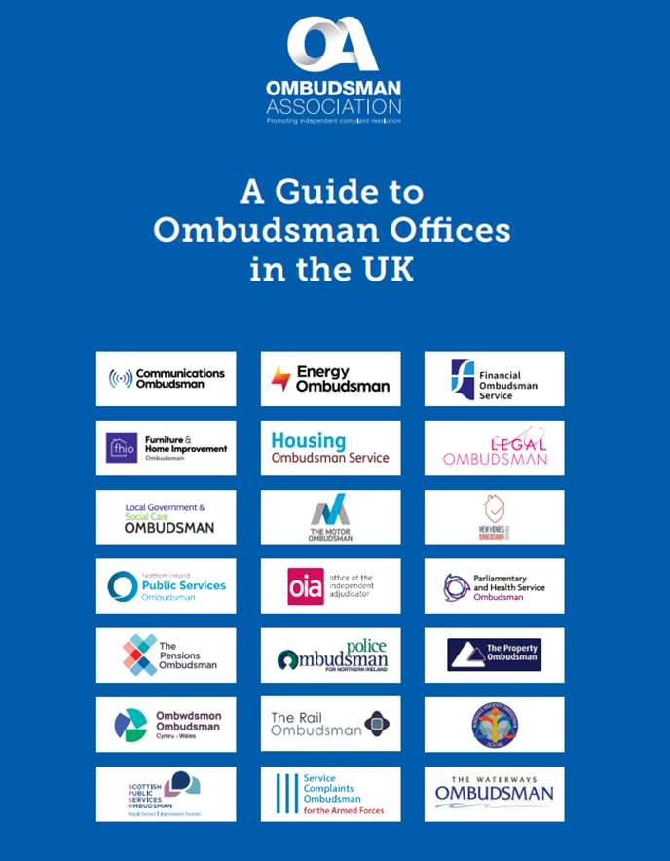
All aspects of life
Across the UK: 22 Ombudsman Members
(and 17 Complaint Handler Members)
  Public services (central, local, devolved)
  Financial services
  Armed forces
  Police
  Care homes
  Legal services
  Pensions
  Property / Housing
  Higher Education
  Essential services (e.g. energy, communications, rail)
  Consumer goods (e.g. cars, home improvements)
Notes:
Ombudsman schemes are an alternative to the Courts - an independent redress model, free at the point of use for citizens and consumers, that can drive systemic change, tackle injustice, and help organisations (whether public or private) to perform more efficiently and effectively.
In terms of the UK: 22 Ombudsman Members and 17 Complaint Handler Members - cover both public services and those in the private / consumer sector. That includes both statutory offices, that are compulsory for all providers in that sector, and those schemes that are voluntary for the sector in question.
Covering complaints about everything from the NHS; energy companies; Financial services; Legal services; broadband; care homes; fitted kitchens; trains; housing etc…

Slide 6
Role of an Ombudsman
Complaints are ‘a window into the soul of an organisation’
An Ombudsman = Champion for Fairness (“Unsung heroes”)
Identify systemic issues and provide feedback to improve services and complaint handling
Unique intelligence: > Million complaints each year, Thousands of lived experiences
Notes:
Window: complaints reveal true culture in an organisation, not the stated one. And can provide an early warning system on potential systemic process or service design failures.
Ombudsman schemes, which were described by the Master of the Rolls (at the launch of the Online Procedure Rules Committee) as “the unsung heroes of the justice system”, offer more than just basic transactional complaint handling which simply picks a ‘winner’ in a dispute. Resolving an individual dispute is of course key to those individuals involved, but the real value in the ombudsman model is their role in feeding back the lessons from their work in order to help secure redress for others in a similar situation, and to improve service delivery and complaints management for the future; all based on what is ‘fair and reasonable’.
For that reason, an ombudsman is sometimes described as being more like a doctor than a police officer, diagnosing what is wrong and making recommendations to improve. And it is in that guise, as an ‘agent of change’, that they can play a role in rebuilding trust and public and consumer confidence.
As a result of those 22 Ombudsman schemes dealing with over a million complaints each year they have a treasure trove of 1000s of ‘lived experiences’ of people's problems with a range of public services and private sector organisations.
But unfortunately, due to capacity and resource constraints, ombudsman schemes often struggle to measure the impact their work is having and the difference they make more broadly. And that’s where LGSCO’s collaborations with researchers comes in…

Slide 7

Research engagement at LGSCO –
Why and how?
Mike Hyatt
Professional Practice Lead

Slide 8
Who are we?
What do we cover?
All English councils
Some other local public bodies – fire, national parks
Private adult social care – care homes, domicillary care
What sorts of issue?
Complaints about everything from…. bins to benefits, special educational needs to street-lights
Including jointly – with Health Service Ombudsman, Housing Ombudsman

Slide 9
Who are we?
What do we do?
Decide whether we can and should investigate - If so – look at what happened, what should have happened? What’s the consequence when things went wrong?
Does action need to happen to prevent this reoccurring – lessons learnt – service improvements
Publish almost all our decisions (anonymized) : www.lgo.org.uk/decisons
Searchable database – great free research resource (according to researchers who have used!)
Notes:
Over 15,000 complaints and enquiries
Over 4000 detailed investigations
2300 cases with recommendations to put things right

Slide 10
Why we want to engage with research
1000s of ‘lived experience’ decisions every year – many with key lessons for public service improvement
Wider ‘lessons learnt’ focus reports to help organisations avoid mistakes made by others
Our resources and remit limited to checking compliance – did you do what we agreed?
Can’t check longer term or wider impact - We are data rich… but intelligence poor
What difference do we make? Particularly in context of failing public services - Are we just noise in the system?
Notes:
Two types of decision – decision statements (c4000 last year) and reports (c30 last year)
In both, our service improvement recommendations – put onus on organisations to learn and fix themselves
Calls for binding powers
Context of widespread system failure – e.g. Special educational needs and disabilities
Are we just ‘noise in the system’?

Slide 11
Worked examples (1)
Blavatnik Institute – University of Oxford:
  Adult social care: How do local authorities react to being issued with a public report?
    Immediate and long term effects
    Impact on performance and behaviours
    Credible causal explanation – control group
  Quantitative research – testing our ‘intervention’ of public reports
  Strong correlation between our reports and reduced maladministration vs control
  Concluded: “… the ombudsman is remarkably effective at regulation inside government”

Slide 12
Worked examples (2)
University of Manchester:
  Ongoing (Nuffield Institute funded) research – Impact of SEND reports
  Concerned about our relevance in a ‘broken system’
  Qualitative interviews with senior officers about long term consequences
  Early conclusions – we have real impact – particularly as leverage for influencing senior politicians

Slide 13
How we want to work with you
Outline of our research priorities
Understanding impact
Particularly children’s social care and adult social care providers
We triage research proposals – to focus our time on those with most impact

Slide 14

Working with the LGSCO
Dr Han Wang
Lecturer in Economic Geography, University of Southampton

Slide 15
Where it began: the research motivation
Context
Postdoc at Oxford Blavatnik School of Government (2022-23)
Working with Thomas Elston on local government reform (IMC)
Research need
Service quality is hard to observe with administrative indicators alone
Complaints data offers a user-facing signal of failure and improvement
We needed long time coverage and service-specific detail

Slide 16
First contact: from data request to shared interest
First contact
Reached out to Mike Hyatt (LGSCO)
Framed the ask around public value + rigorous evaluation
LGSCO responded quickly and constructively
Early collaboration
Data shared for research with clear expectations
Iteration: early descriptives → questions → interpretation checks
Trust built through responsiveness and clarity

Slide 17
The HEIF Engagement Fellowship
Why the grant mattered
Applied for Oxford HEIF Engagement Fellowship
LGSCO joined as an official partner
The grant created time, structure, and a shared “project logic”
What it enabled (in practice)
Deeper engagement despite late-Covid constraints
Access to LGSCO internal network for problem-solving
Regular exchanges with colleagues (especially data/reporting teams)

Slide 18
What “insider researcher” access looked like
Two types of access
Data access
  structure, field meanings, changes over time, missingness
Process access
  investigation steps, escalation logic, when cases stop, what “maladministration” means operationally
Why this improved the research
Faster learning curve; fewer wrong assumptions
Better measurement choices and more credible interpretation
Kept independence intact: support without steering results

Slide 19
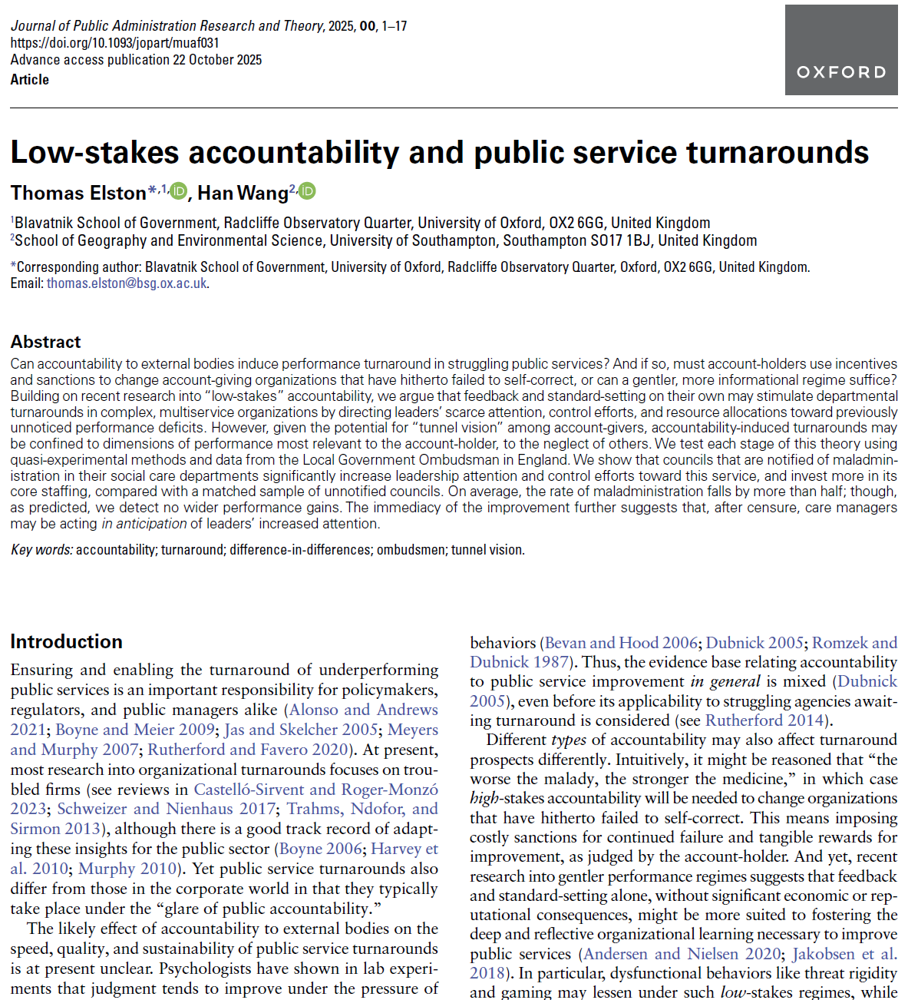
What we found in the paper
The question
Can low-stakes accountability trigger turnaround in a struggling service area?
Headline results
Maladministration falls by ~57% after notification (on average)
Councils increase: leadership attention (more top-level “key decisions”); control efforts (more internal audit focus) ; core staffing, especially frontline roles

Slide 20
Lessons for HEIs & outlook
What other HEIs can take away
Start with a public value narrative, not just “data extraction”
Build a shared workflow: plain language, shared definitions, quick feedback loops
What helps partnerships scale
Small seed funding (e.g., HEIF-style fellowships) can turn informal contact into sustained collaboration
Future opportunities
Multi-service learning: social care, housing, benefits, education
Strong place lens: geocoded patterns can support targeted improvement and inequality reduction

Slide 21
Why now? Call for action
Total cost of consumer detriment in the UK est. £71.2 billion (DBT, 2024)
Increasing demand in every sector across UK:
  Communications Ombudsman up 54%; Housing Ombudsman and Motor Ombudsman both up 42%; Scottish Public Services Ombudsman up 39%; Legal Ombudsman 37%...
Policy solution of choice: Water industry, Private Rented Sector…
And yet, HMT Review of Financial Ombudsman Service…
Ethics & Integrity Commission review on reform (March 2026)
Ombudsman sector is keen to engage – get in touch!
Notes:
People’s rights have never mattered more:
DBT’s Consumer Detriment Survey 2024 showed 7 in 10 UK consumers had a negative experience with an item or service (in 12 months to April/May 2024) – poor quality products, being defective or unsafe, delivery issues, and complete failure to provide. Total cost of consumer detriment in the UK estimated £71.2 billion (up from £54 billion in 2021)
MoJ Legal Problem and Resolution survey (2023) showed that ‘certain groups of the population are far more likely to experience problems than others (people from ethnic minority backgrounds, adults with long-term health conditions, those on means-tested benefits, and single parents).’
And Citizens Advice have a whole webinar series on the ongoing impact that the cost-of-living crisis is still having on ‘working people’
Increasing year on year demand across ombudsman sector (Institute for Fiscal Studies research re. public sector ombudsman realm).
History has frequently been that the victims of injustice have often struggled to have their voice heard until a scandal, tragedy, or major failing occurs – after it does, creation of an ombudsman, or expansion of an existing one, is regularly part of the Government’s preferred policy solution e.g. Water industry and Private Rented Sector.
But at the same time the Treasury Review of FOS has questioned the value of the ombudsman, the ‘fair and reasonable’ approach, claiming it creates uncertainty for businesses and so constrains economic growth… so there is clearly a need for greater understanding of the impact ombudsman schemes have.
Ethics & Integrity Commission review – following CSPL 2025 report into ‘Recognising and responding to early warning signs in public sector bodies’, which questioned the value of public inquiries, EIC’s first review will ‘look at whether ombudsman schemes in the public sector should play a greater role in investigating systemic issues before they escalate and supporting public bodies to instigate swift and meaningful improvements to public services’.
So, the services that ombudsman schemes provide are in unprecedented demand, the data they hold and insight they provide is unique, and regularly seen as essential by Governments’ seeking to address systemic issues and drive change, and yet at the same time there is uncertainty over how much impact they do have – all at a time when organisations are expected to justify their existence and value for money.
So we think this provides a great opportunity for researchers to tackle questions that really matter for citizens and to help drive improvements - and the sector is keen to engage! We have research and policy networks that draw together all of our members and I’m happy to act as a facilitator to help anyone interested get in touch with them.

Slide 22



Get in touch
Email: donal.galligan@ombudsmanassociation.org
@OmbudAssoc
@OmbudsmanAssociation
That OA Thing – Podcast (YouTube and Spotify)
www.ombudsmanassociation.org

Slide 23
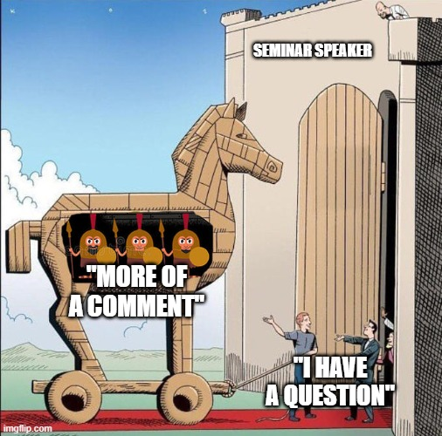
Q&A
Any questions?
Notes:
Q&A
Invite questions or feedback from attendees.

Slide 24
Many thanks for coming along to this UPEN event:
Public data for the public good: working with Ombudsman Schemes
Please take a few moments to complete our post event survey
If you’d like to stay in touch with all the latest news and opportunities from UPEN, please Sign up for UPEN's newsletter and Follow UPEN on LinkedIn
UPEN – 25 Feb 2026

